Slide 1

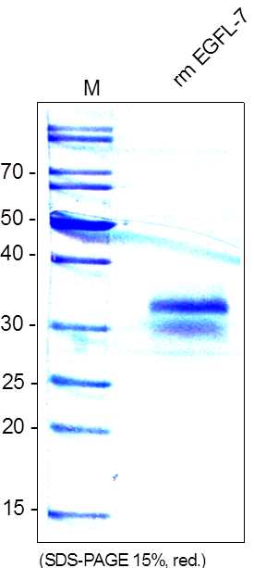
ReliaTech GmbH
Recombinant mouse EGFL7/VE-Statin
(Cat# M30-100)
Fig. 1: SDS-PAGE analysis of recombinant mouse EGFL7/VE-Statin produced in insect cells. Sample was loaded in 15% SDS-polyacrylamide gel under reducing conditions and stained with Coomassie blue.
http://www.reliatech.de / orders@reliatech.de

